Slide 1
Module 1:
Mindfulness-Based Interventions for Youth
Facilitator:
Kati Simpson

Slide 2
For this module in Mindfulness…
Apart from delivering the educational aspect of the module, my intention is to also facilitate a space where we can nurture our innate capacity to witness our inner and outer experiences of the moment to moment unfolding of the NOW.
Also and more importantly, to bring a curious ”child-like mind” together with kindness and compassion to ourselves and those around us. Compassionate deep listening to your needs is crucial. Please give yourself permission to do plenty of self-care anytime your body and/or mind calls for it.
“It is only in safety that we develop, and it is only in safety that we heal”
(Gabor mate)
Healing= to be whole. That is the goal.
The nature of how we participate on these two days is more important than the goal you want to achieve at the end of the module, because how you participate will determine, to a significant degree, your capacity to reach your goal.

Slide 3
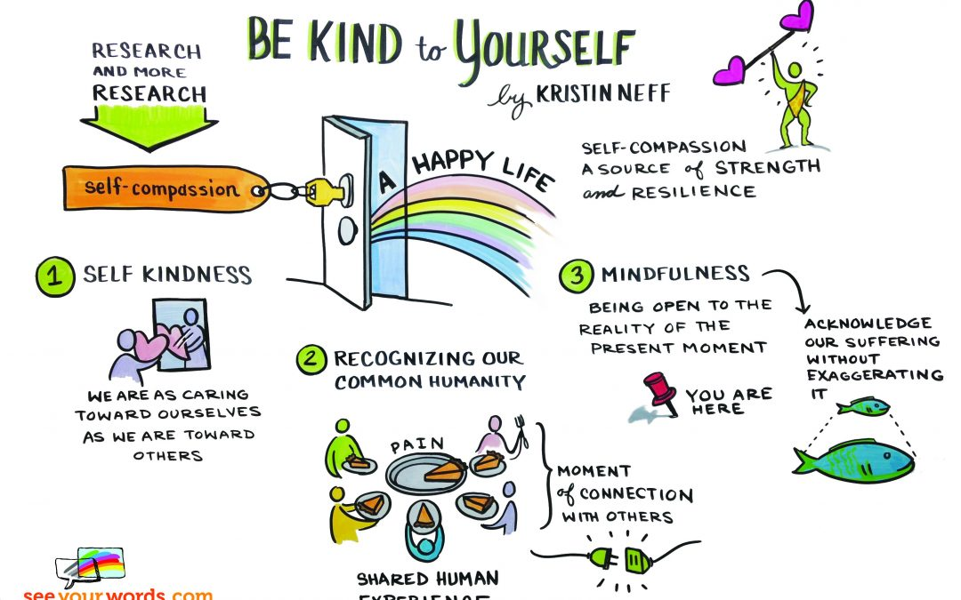

Slide 4
Module Content = Blended Learning
Didactic Learning
Definition
Psychological Model
Mechanisms of Change
Proposed Benefits
Integrating into Clinical Practice
Recognizing what we are training: the unsettled mind
How to settle the mind with Formal and
Informal practices
Practices beneficial to young clients
Experiential Learning

Slide 5
Mindfulness Definition:
“The awareness that arises from paying attention, on purpose, in the present moment and non-judgmentally to the unfolding of experience moment to moment ”
(Kabat-Zinn, 1984, p.4),

Slide 6
Mindfulness is the English translation of the word in Pali language Sati = remembering.
Remembering what?
To be in the present moment, the only moment we are truly alive, the only moment life is happening, the only moment we can give and receive love. Also remembering that your mind when not in the present moment with the task at hand will more likely be lost in negative thoughts.
In 2005, the National Science Foundation published a study where they found out that the average person has about 12,000 to 60,000 thoughts per day. Of those thousands of thoughts, 80% were negative, and 95% were exactly the same repetitive thoughts as the day before.
A study from Harvard (Killingsworth & Gilbert, 2010) with 5000 people, from more than 80 different countries and ages between 18 and 88 have showed that we are 47% of the time not aware of what we are doing. This study linked mind wandering with subjective experience of unhappiness, the paper entitled “A wondering mind is an unhappy mind”.

Slide 7
A research done by Cornell University (Leahy, 2005) demonstrated that 85% of what we
worry about never happens and of the 15% of thoughts that do happen 79% of the
participants mentioned that the event was not as bad as the predictions they had
about it.
Mindfulness Based Interventions understanding is based on the acknowledgement that a wondering mind is indeed an unhappy mind because a wondering mind tends not to wonder in the good of life, but to be on the lookout for danger. Where you place your mind will deeply impact how you feel.

Slide 8
Lutz et al. 2008 speak about the need for the development of at least 3 major skills if Mindfulness is to be developed:
Focused attention (or concentration)- Staying with a chosen object (losing it and returning to it) with an open, curious attention and in doing so developing stability of mind which will support other skills to be developed. Without concentration it is very difficult to be able to see the workings of the mind in depth.
Open monitoring (or mindfulness per se) – Here instead of returning to the chosen object repeatedly, the focus becomes whatever is predominant in the mind. A thought, a physical sensation, an emotion, we learn to not think or analyze them, but to be with it, bringing an attitude of interest, curiosity and acceptance to the experience.

Slide 9

One way to understand the relationship between focused attention and open monitoring is by thinking about photography before cameras were automated. In those days, to get a clear picture, you first had to know how to focus the camera lens. Without this skill, a photographer was limited to abstract, impressionistic, blurry images. Learning to concentrate is like focusing the mind’s lens—it allows us to see clearly
whatever we turn our attention to. Once this skill is developed, we can use it to examine whatever might be happening at the moment.

Slide 10
And Attitude or Compassionate Acceptance
This quality involves non-judgment, curiosity, trusting, non-striving, kindness, compassion, acceptance, patience and letting go (Kabat-Zinn, 2010)
…an attitude of openness and receptivity to whatever arises, as a “quality of attention which notices without choosing, without preference” (Goldstein & Kornfield, 1987, p.19).
Attitude relates to the quality of how one is attending to phenomena.

Slide 11
Warm, friendly, compassionate light
Notes:
Choden analogy of dark room full of cobwebs and pile of unwated stuff

Slide 12
A Compassionate Heart
First, to have compassion for others you must notice that they are suffering
Second, compassion involves feeling moved by others’ suffering so that your heart responds to their pain (the word compassion literally means to “feel with”).
Having compassion also means that you offer understanding and kindness to others when they fail or make mistakes, rather than judging them harshly.
Finally, when you feel compassion for another (rather than mere pity), it means that you realize that suffering, failure, and imperfection is part of the shared human experience.
“Self-compassion involves acting the same way towards yourself when you are having a difficult time, fail, or notice something you don’t like about yourself. Instead of just ignoring your pain with a “stiff upper lip” (Kristin Neff)

Slide 13
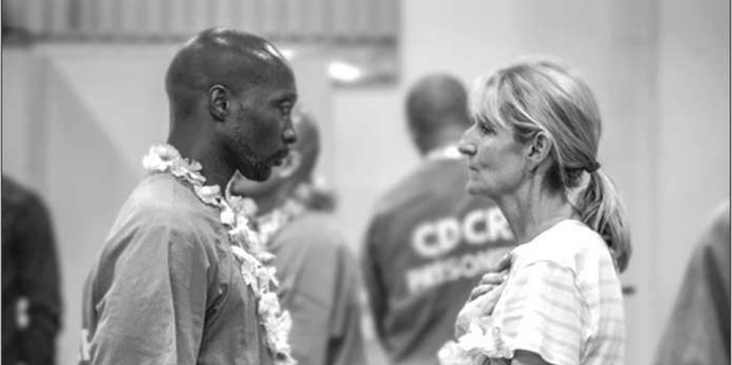
https://www.youtube.com/watch?v=FVxjuTkWQiE
Step Inside the Circle

Slide 14
The way they achieve bringing inmates to feel compassionate towards themselves is by explaining the impact childhood trauma has on them.
Asking them to fill out the ACE questionnaire is one of the ways they bring the inmates to recognize that they have been traumatized as children and that they have been suffering with unrecognized symptoms of childhood trauma all their lives. Compassion for self and other work was also delivered.
Compassion= understanding suffering and aiming to alleviate it. Not passive understanding.
Self-compassion= understanding our suffering and aiming at alleviating it. You can't alleviate what you don’t recognize. Mindfulness is a way to support you. Because you are becoming more aware of your inner and outer experiences and is better able to observe your own mind. It gives you the opportunity to choose if this is the path you want to take or not rather than acting on impulse.
ACE’s questionnaire: https://www.npr.org/sections/health-shots/2015/03/02/387007941/take-the-ace-quiz-and-learn-what-it-does-and-doesnt-mean?t=1655460234442
More on ACEs= https://www.ted.com/talks/nadine_burke_harris_how_childhood_trauma_affects_health_across_a_lifetime?language=en

Slide 15
3 Phases and phrases
Now, put your hands over your heart, feel the warmth of your hands and the gentle touch of your hands on your chest. Or adopt the soothing touch you discovered felt right for you.
Say to yourself:
1. “This is a moment of suffering”
That’s mindfulness. Other options:
“This hurts”
“Ouch”
“This is stress”
2. “Suffering is a part of life”
That’s common humanity.
Other options:
“Other people feel this way”
“I’m not alone”
“We all struggle in our lives”
3. “May I be kind to myself”
That’s action! Trying to alleviate suffering!
You can also ask yourself, “What do I need to hear right now to express kindness to myself?”
Is there a phrase that speaks to you in your particular situation, such as:
May I give myself the compassion that I need
May I learn to accept myself as I am
May I forgive myself
May I be strong.
May I be patient

Slide 16
Fundamental Components of Mindfulness – Operational Mechanism
Shapiro et al. (2006)

Slide 17
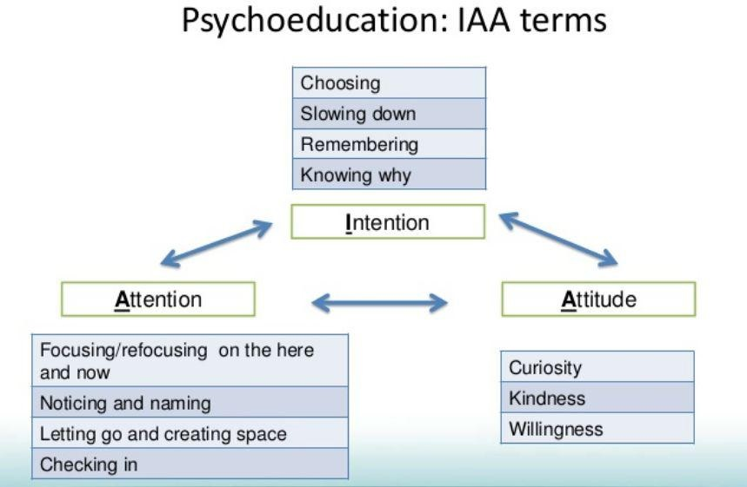

Slide 18
Dr. Shauna Shapiro on Mindfulness:
https://youtu.be/IeblJdB2-Vo

Slide 19
Starting Where We Are
Practice: Recognizing the unsettled mind – monkey mind

Slide 20
How to deeply settle the mind: Settling, Grounding, Resting with Support of Sound Practice
Posture
Intention/motivation the What will I do? And the Why Am I Doing it?
Settling - Give the mind something to concentrate on – breathing and adding another object if the mind is still very busy which is the counting.
Grounding – another practice to help the mind to stay in the present moment – noticing bodily sensations. It helps in grounding and strengthening the body-mind connection.
No analysis, just bare noticing.
Resting – Nothing else to do. Becoming the observer of the mind.
With Sound – Simply noticing sounds as a way to remain in the present moment. Noticing what attitude you hold towards what is unfolding in your inner/outer experience. Patterns, judgement, reactivity. Learning to respond rather than react.
Notes:
15 mins

Slide 21
Germer et al. (2005) speak about 3 most common ways mindfulness have been utilized in therapeutic work :
1- Through the Mindful Presence of the Therapist
2- Integrated into Psychotherapeutic Models such as Gestalt, Person-centered, CBT
3- Psychotherapeutic Models rooted in Mindfulness or “Mindfulness-Based Interventions” such as ACT, DBT, MBCT.

Slide 22
This weekend have concentrated in Integrating Mindfulness in our work with young persons through the Mindful Presence of the Therapist (developing present moment awareness and understanding the importance of compassionate attitude).
It has been argued that mindfulness-based interventions failure to positively impact outcomes was linked with the clinician’s lack of experiential knowledge of mindfulness (Mindfulness Based Cognitive Thearpy – Mark Williams, Zidel Segal, and John Teasdale).

Slide 23
The Importance of Therapist’s Mindful Presence in Psychotherapy
Presence in psychotherapy is a fundamental underlying quality that needs to exist in an effective therapeutic relationship. It is a state of encountering the other in the moment-to-moment experience, on multiple levels such as: physical, emotional, and cognitive.
Presence supports deep listening and understanding of the client in the present moment. It is known to foster deep client-therapist alliance as therapists are in tune with their own inner and outer processes and at some level also attuned to the clients inner and outer processes. This kinaesthetic and emotional sensing of the other leads to an attuned responsiveness where therapists are better able to respond to what is, rather than to what is not.

Slide 24
“ I am inclined to think that in my writing I have stressed too much on the three basics conditions (congruence, unconditional positive regard, and empathic understanding). Perhaps it is something around the edges of those conditions that is really the most important element of therapy- when my self is very clearly, obviously present”
Carl Rogers – Person-Centered Psychotherapy

Slide 25
Sensorimotor Psychotherapy
“ In mindfulness awareness, you and your client both notice how the experience of the story unfolds in the present moment, through changes in the sensation, movement, sensory perception, emotion and thought. This is not a solitary endeavor; both parties are attending to the ebb and flow of the client’s present moment internal reactions. Taking place within an attuned dyad, mindfulness activates not only your client’s experience of the effects of trauma and attachment inadequacies, but also increases the engagement and connection between you and your client” (Ogden, 2015, p. 132)

Slide 26
“The most effective therapists know the research and have a dynamic approach to treatment options. The research indicates that effective therapists form a strong therapeutic alliance across the range of patients seen in therapy. They are able to form a bond with their patients, regardless of the patient’s characteristics, and induce the patient to accept the treatment and work collaboratively with the therapist. Effective therapists have an ability to perceive, understand and communicate emotional and social messages with their patients. It also appears that effective therapists are cognizant of patient progress, either informally or through the use of outcome measures, and are willing to address issues that impede therapeutic progress, including the relationship between the therapist and the patient” (Wampold in APA, 2009).

Slide 27
“Who you are as a therapist is much more important than anything you say or do…The therapist is a mirror to the client so you must be in the present self so the client can be too. If you are too identified with your role you cease to be present with your client. If you stay in your mind you miss what is in front of you. So bring all three knowings to the encounter in the present moment: mind, heart and gut feeling… One o the important reasons for you to be aware of your own present moment situation is so that you stop assuming that you know what is best for your clients…
When you address your clients with a need for them to feel better, you become the person who needs something from them for you to feel better. In doing so you re-create the traumatic figure in their life who needed something from them”.
Gabor Mate - Compassionate Inquiry

Slide 28
The intention in mindfulness is to learn to not buy into every thought that arises in the mind stream, to not turn passing thoughts into facts. We learn to become the observer of our inner and outer environments with an attitude of curiosity, non-judgement, acceptance, kindness, compassion. We begin to understand that we have a strong tendency to project and perceive ourselves, others and the external world mostly based on past experience. Non shaming way of seeing ours and others imperfections. Mindfulness gives us a key to unlock a new way of being in this world. Deepening the lived experienced of the now not only with our minds, but also with our body and soul
.

Slide 29
Mindfulness and Psychological Outcomes for Youths
Literature has demonstrated that youths most described benefits from practising mindfulness relate to enhanced present-moment awareness, self-regulation and wellbeing (Brown et al., 2003; Weare, 2013).
Present-moment awareness has been defined as “ a continuous monitoring of experience with a focus on current experience rather than preoccupation with past or future events” (Cardaciotto et al., 2008, p. 205). Some researchers contend that mindfulness training, purposefully facilitates the development of a receptive state of mind where attention is directed towards the bare observable facts of reality, without the habitual mind chatter, but as an observable stream of inner and outer phenomena (Brown et al., 2004). The benefits of mindful awareness have been linked with a myriad of psychological benefits such as improvement of wellbeing, increase in mood, reduction in perceived stress, anxiety and depressive symptoms (Brown et al., 2004).

Slide 30
Growing evidence in self-report, physiological and neuroimaging methods shows that mindfulness also improves emotion regulation (Baer et al., 2009).
Emotion regulation has been defined as a process of regulating arousal and expression of emotions in a way that is flexible and per environmental demands (Wang & Saudino, 2011). Hozel et al. (2011) argue that many psychological disorders are linked with a reduction in emotional regulation capacity and are frequently associated with a reduction of prefrontal activation and over-amplification of amygdala activation.
“Mindful attention to and labelling of these components [thoughts, emotions, perceptions, movements, and sensations] of internal experience can lead to improved autonomic self-regulation and increased self-awareness” (Ogden, 2015, p.132)

Slide 31
A brain region that determines how much stress we experience is the amygdala. The amygdala is responsible for modulating our fear responses. A study conducted by the American National Institutes of Health, demonstrated that mindfulness meditation reduced the activity of the amygdala and impacted in size changes of this area after 8 weeks of training (Wilson, 2013).
Studies indicate that the amygdala’s reaction to stressful situations is more excessive in adolescents than in adults due to immature executive functioning (Hare et al., 2008). Practising mindfulness has been shown to activate the prefrontal area and improve prefrontal control over amygdala responses (Hozel et al., 2011).

Slide 32
The third most noted benefit for young persons after practising mindfulness relates to increase in wellbeing.
Meta-analytic studies have shown this to be primarily linked with perceived decrease in stress levels (Weare, 2013; Erbe & Lohrmann, 2015). Stress has been defined as a reaction at a physiological, cellular and emotional level, which is either an internal state of the organism or an external event that ignites internal stress states (Mason, 1975). Each individual has their unique tolerance levels, and the stress response kicks in when the level of stress is higher than the average tolerable measure. Exposure of high levels of stress hormones for a certain period of time may lead to hippocampal damage which increases sensitivity to stress-related disorders such as PTSD, Panic disorders, GAD and Acute stress disorders.

Slide 33
Donald et al. (2016) study demonstrated that when practising mindfulness, adaptive-stress responses can be facilitated by present-moment awareness. It can also offer a way of reducing stress-induced mental ‘time travel’ (worrying about the future or ruminating about the past) which nurtures relaxation and can ignite an approaching and acceptance, rather than avoidance coping mechanisms.

Slide 34
Neuroplasticity
Dan Siegel defines neuroplasticity as “…the term used to describe the capacity for creating new neural connections and growing neurons in response to experience” (P.34).
“One of the key practical lessons of modern neuroscience is that the power to direct our attention has within it the power to shape our brain’s firing patterns, as well as the power to shape the architecture of the brain itself (P. 59).
Internal and external experiences are constantly shaping the brain.

Slide 35
Mindfulness Meditation and Neuroplasticity
Through practices in focusing attention, it has been argued that meditators are strengthening neural circuity related to voluntary control of attention. A recent study at Massachusetts General Hospital mentioned in the article “Mastering Your Own Mind” (2013), showed evidence that 40 minutes of daily meditation appears to thicken parts of the cerebral cortex involved in attention and sensory processing. MRI scans have demonstrated that long-term practitioners had actually altered the structure and function of their brains (Davidson, 2010).
Through practicing loving kindness and compassion practices, meditators have shown to develop areas of their brains linked with positive emotions in only 2 weeks, 30 mins per day.

Slide 36
We become more aware of patterns of behaving and reacting. We can look at our usual strategies we have when trying to avoid, deny, suppress what the mind translates as unpleasant. Learning to stay with whatever arises, or at least turn towards what is difficult. Above all we develop a deep compassionate understanding on how the past has shaped our way of being and we stop the shaming and blaming ourselves for how we are in the now.
Turning towards self with kindness

Slide 37
Insight dialogue ( 5mins sharing each+10 mins debriefing=20 mins)
Decide who is talking first and who is listening. You will need an alarm to be set for 5mins for each person sharing. Closing your eyes is an option when listening or speaking during this practice.
For 5 mins without being interrupted you share how the day is going for you so far. What are the insights you may have gained about your patterns of projecting, assuming, reacting, behaving, thinking, feeling, sensing? What is arising for you as you share?
Use mindfulness to drop from your head into your body. If you begin to get caught up in your head, bring your awareness to your feet. Noticing and narrating sensations, emotions, feelings, thoughts, urges, patterns, reactivities that are arising within you as you share. Pause as much as you need to in order to reconnect with your body.
The listener’s role is to listen only. To be mindful of his/her own emotions, feelings, sensations, thoughts, reactivities, urges, patterns, etc. As best as we can we refrain from adding anything as we receive their story. Practicing deeply listening to the other and to self.
Talker and Listener = Noticing what is unfolding in the “in between” you two.
Swap roles and practise again.
Debrief for 10 mins.
Notes:
Copy and paste into the conversation box.
Tell them to read the comment box in group chat

Slide 38

Discussion:
What did you notice about this practice?
Did you find it easier to settle the mind with this practice or did you mind wondered more?
Where there any sensations that you felt difficult to stay with? Or maybe areas of your body?
What was your attitude towards what you experienced?
Can you see this practice benefiting any of your existing or future young clients?

Slide 39
Module 2:
Mindfulness-Based Interventions for Youth
Facilitator:
Kati Simpson

Slide 40
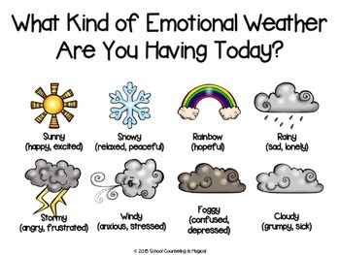

Slide 41
Body Scan
Rationale:
Importance of strengthening the mind-body connection. Bring the mind where the body is. “Our intent is not to feel better, but to get better at feeling!” When we get better at feeling, we have a better chance of feeling better because we can try to offer support and resource our difficulties (Brown, 1962).
Body scan helps us to acknowledge raw sensations with mindful sensitivity which gives us a more balanced awareness of our inner landscape – feelings, emotions, thoughts, perceptions, all manifesting in the body as bodily sensations.
Learning to become aware of the wisdom within the body = not forcing anything!
Remember that 1 in 4 children in Ireland have suffered some sort of sexual boundary violation, therefore we go easy and gently with bodily based practices. Not noticing anything is ok, normalize fear of bodily sensations, give them a way out (sounds).

Slide 42

Notes:
One sleeping, other trying very hard. Better to sleep then to strive too hard.

Slide 43
Practice: Most favored practice with adults and youths
Formal practice included in all Mindfulness-Based Interventions
The Body Scan

Slide 45
The body scan practice is the most used practice with youths.
Many adolescent clients have used the Body Scan practice to help them with sleep issues. When sharing this practice with young people make sure that the practice is short. Use the MBLC-YA app or make your own recording.

Slide 46
What we have learned in the last module
Definition on Mindfulness: “The awareness that arises from paying attention, on purpose, in the present moment and non-judgmentally to the unfolding of experience moment to moment ”(Kabat-Zinn, 1984, p.4).
How it works: IAA Model: Intention, Attention and Attitude (Shapiro, 2006).
Neuroplasticity and brain changes that occur when practicing mindfulness
Importance of therapist’s mindful presence in psychotherapy.

Slide 47
Using the IAA Model in our Work as Adolescent Psychotherapists
Intention: What motivates me to work with adolescents? This frames your work and also helps you when you encounter difficulties in your work.
Attention: Therapist’s Present Moment Awareness of inner and outer processes within self and with the other. It can be deepened and further developed by practising Formal Practices such as the SGRS and Body Scan and Informal Practices such as the 3 mins breathing space, landing practices, insight dialogue.
Inner Landscape: Becoming aware of our thoughts, emotions, feelings, bodily sensations, perceptions, patterns of being, reacting and relating to ourselves.
Outer landscape: By practicing insight dialogue we become aware of the other: what is happening with the other, also aware of how that the present-moment experiencing of the other is impacting me. Noticing patterns of behaving, reacting and of relating to the other.
Attitude: Importance of attitude to how we observe our inner world an or clients too (acceptance, kindness, compassion, non-judgement, curiosity).

Slide 48
Today we will look at ways we can integrate Mindfulness in our work with adolescents.

Slide 49
My rationale for using Mindfulness Based Experiments in Youth Psychotherapy
1- To Restore Integrity – Beginning with restoring balance with Wellbeing at a body level first.
Teach skills for self regulation such as the body scan, 3 mins breathing space, self-compassion break
2- For Caregiver attunement. Psychoed about the brain in sessions with young person. Mindful awareness of how our inner state affects our children. Need to self-regulate in order to regulate. Self-compassion break for parents. Teaching parents to maybe for the first time asking themselves “who is this person in front of me?” curious awareness towards their child.
3- For Meaning Making – shame addressed , grieve what happened and what did not happen. When the therapist practices Mindfulness of listening, Mindfulness of speech, Mindfulness of Action (meaning being present, embodied, not projecting, curious, accepting and compassionate) there are more chances for clients showing the parts in them they feel ashamed about and had not yet integrated.

Slide 50
Integrating Mindfulness Practices in Therapeutic Work with Youth
WHY and HOW
We try to make it as relational as possible. Utilize language that is invitational.
Therapy by proxy “I have a few clients your age that found this exercise very helpful…I wonder if you would be interested to see if it is helpful to you?” Introduce with caution. Many adolescents have had bad experiences with mindfulness in school. Some young people are too scared or embarrassed to say no. Watch for bodily clues. I do not use the word mindfulness, but “ Would you like to do an experiment to see if it is helpful to you?”
Give a rationale for practising. Explain how to practice. Lead a practice in session. Invite client to share how they felt during the practice. Send guidelines on how to practice or share an audio practice (MBLC-YA) to the parents to share with young person. I will be sending recordings for you to share with your clients (adults and teenagers).

Slide 51
Integrating mindfulness in clinical work requires that the therapist have experience practising mindfulness as he/she must teach from a place of experience and understanding. Tracking the client from the beginning, middle and end of a practice. Inquire into their experience. Integrate.

Slide 52
Practices need to be recommended based on age. Young adolescents (11-14) find easier to practice: mindful coloring, eating chocolate (instead of raisins), and body based practices such as yoga and movement practices. Make it short (no longer than 5 mins).
For older teenager (15+) Movement practices, body scan, breathing with counting, 3 mins breathing space seem to be easier than breath and thought observing practices (max 10 mins).

Slide 53
Harm and Difficulties
To date, no research has demonstrated that mindfulness causes harm to adolescents (Tan, 2016).
However, literature shows that young persons find extremely difficult to practice practices that are passive in nature such as breathing meditations. Adolescents find easier to practise bodily focused practices such as the body scan. They also find more motivating and more likely to practise practices that have a good rationale and whose benefits can be felt fast.
Sylwester study in the adolescent brain (2007) speaks about the limited capacity for attention in adolescents, which increases over time, therefore making tangible and clear practices less likely to activate boredom, impatience and distraction.
GOOD RATIONALE= STRONG MOTIVATION FOR DOING THE PRACTICE
A strong motivation for doing any practice for teens is to alleviate their suffering. Ie. Anxiety, stress, depression, etc.

Slide 54
RESTORING INTEGRITY (PHYSICAL,EMOTIONAL)
Step1- Psychoeducation about why I am feeling the way that I am feeling is essential (story telling works better than graphs and research details). Main message: “I have seen this before and this helped other people your age (yet I know that you are a unique human being, and I am curious about you, and I empathize with how hard this is for you) AND I wonder if you want to try this?” – Do they buy into this???
“The critical aspect is not which treatment a person receives, but rather that the patient believes this particular treatment is effective and works collaboratively with the therapist”(Dr Wampold in APA, 2009)
Step 2- Affect Tolerance: Learning to stay with the strong sensations by utilizing mindful awareness and mindful questioning.
Step 3- Self-Regulation: Learning to use tools to shift body/mind states.

Slide 55
For clients who are very dysregulated I always begin with resourcing. Wellbeing comes first before anything else.
-Remember “ it is only in safety that we develop and grow” (Mate).
BUT…there is need a bit of arousal in order to work with the body sensation.
That is why I begin my therapeutic work by explaining the Window of tolerance and how we are looking to become EXPERTS about how our bodies are in the present moment so we can bring a lot of kindness to ourselves and look after ourselves as we would look after a very dear loved one.

Slide 56
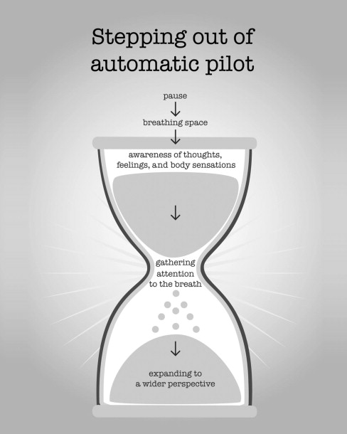

Slide 57
Step 1- Psychoeducation about what is happening with their bodies and how to resource their difficult experiences.
Psychoeducation aimed at explaining the client’s present symptoms and how to ameliorate such symptoms are showed to have a higher buy in with adolescents and their parents. Helping to unburden the client’s system from shame with the acknowledgement that whatever is arising is not the client’s fault or a choice, may be helpful to provide relief for shame and blame.
You can start with teaching about the brain parts and what is happening with their brains and bodies https://www.youtube.com/watch?v=gm9CIJ74Oxw
Naming the emotion/feeling first then

Slide 58
Experiment
Draw a line to divide an a4 page in two. On the right hand side could you write down things you have noticed for the past two days that may cause unpleasant sensations or feelings/emotions? Can you score from 1 to 10 in terms of how unpleasant they were?
Examples:
Auditory/Sounds: clock ticking (8), people chewing loud (10), dog barking (8)
Tactile/touch: velvet (10), seat (5) clothing too tight (4)
Visual: zebra pattern (10), bright light (6) messy room (3) computer screen (9)
Taste/smell: petrol (6), grainy food (8)
Vestibular/movement: high places (10), escalators(7)
On the left hand side of the page can you please write down resourcing activities you have done? Score 1-10 in terms of how resourcing were them.
Examples:
Mindfulness (10), Spraying Lavender (8), Bath (7), Hugging myself (5), painting (6),
Watching Netflix with my friend online (10), hanging out with friends (10).
Do the math for today: compare both scores. If you have had more triggers than resource maybe seeing if it is possible to think about something that you can do today that may help to support you?
Make a list of what stresses you so you can plan your day better! Do the sandwich!
Energy Accounting (sensory input minus resourcing or calming activities = less meltdowns)
Energy Accounting: https://vimeo.com/213640278

Slide 59
During the assessment stage I get curious about their physiology. As I have encountered a lot of children and parents who are unaware of how the environment impacts their nervous system.
The accumulation of sensory input may then cause many children and parents to have big meltdowns.
I use the Energy accounting system. Clients and parents become then more mindful about things that can potentially trigger them and how to look after themselves. Ie “tomorrow I have exams, how can I better look after myself?"
PS: The sensory input difficulties can vary from day to day and sometimes from hour to hour. Some females have disclosed that as they start to become more aware about their inner and outer experiences that a week or so prior to their menstrual cycle starting that they feel certain sounds, smells, textures, etc to cause more irritability, frustration, etc. Many females have disclosed that their OCD tendencies are heightened during this period too. A new systematic review published in 2022 entitled Symptom fluctuation over the menstrual cycle in anxiety disorders, PTSD, and OCD: a systematic review (Green, S.A., Graham, B.M., 2022) contends “The review revealed evidence for exacerbation of a broad range of symptoms in panic disorder, PTSD, social anxiety disorder, OCD, and generalised anxiety disorder, around the weeks prior to and post menses onset…”

Slide 60
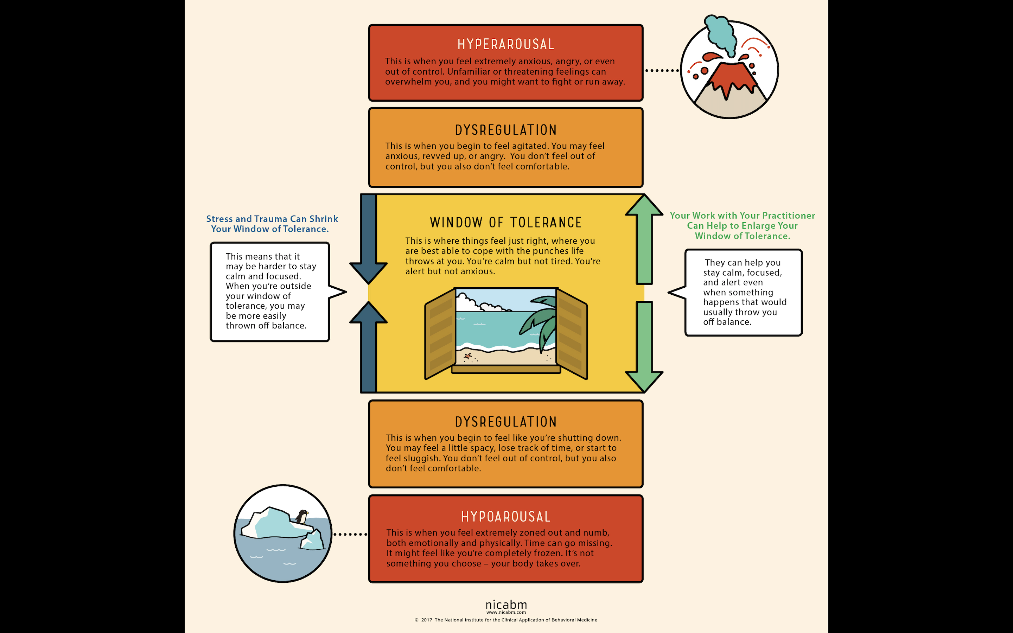

Slide 61
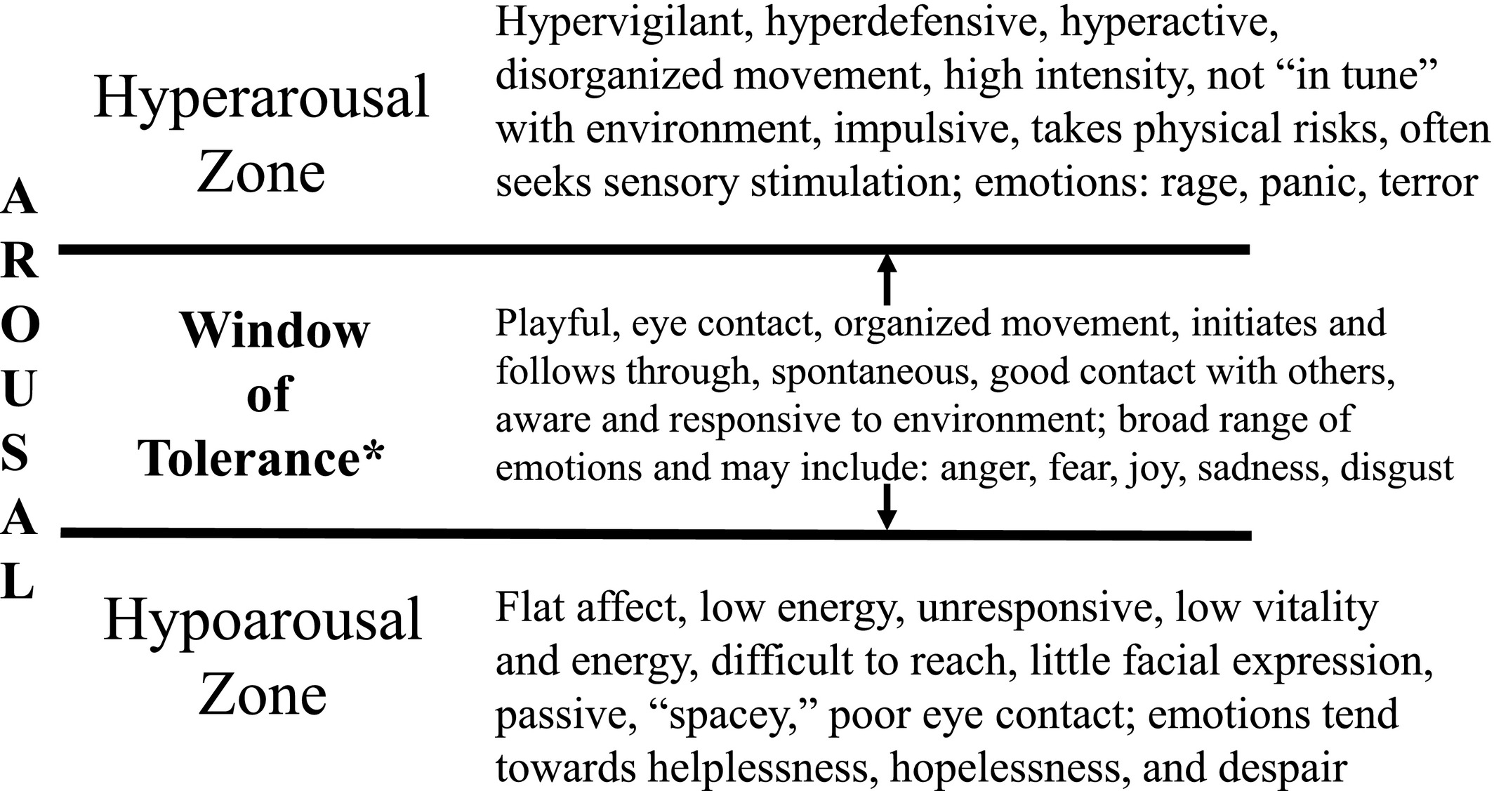

Slide 62
Caution
When adolescents are sharing a difficult situation they have experienced, stopping before they are completely dysregulated may prevent re-traumatization. Using the Window of Tolerance graph we can ask if they notice moving from the centered state to too high up or down. Moving towards hyper or hypo is ok and it helps to tell our stories while at the same time feeling what we may have not been able to feel before.
Trauma research has taught us about the importance of titrating interventions.
Mindfulness awareness here can help the clinician to track the unfolding of moment to moment experience for the client and self, which in turn facilitates respecting the client’s pace without pushing the clinician’s agenda which may result in mood destabilization by going too fast too soon.
A rule of thumb when working with traumatized individuals is to support the feeling of safety before working with repressed memories or uncovering disavowed thoughts and feelings (van der Kolk et al., 1996)
”Generally, it seems that meditation practices that bring our attention to the chest, belly, and throat (such as attending to the sensations of the breath) move us toward the sharp points, while those that focus on objects farther away (such as the soles of the feet, sounds, the taste of food, or the natural environment) tend to be more stabilizing.” (Pollack et al, 2014)

Slide 63
Psychoed done WITH PARENTS so not only the young person ,but parents also can see why and how their bodies and brain are responding to the present experiences (make sense of it all without blaming self) but how to alleviate it (even though it is not my fault I am responsible for my actions so if I want to change there are tools that I can try).
I share this video to the whole family to watch together
Dan Siegel= How our relationship shape us.
https://www.youtube.com/watch?v=fwmtgrWKQrY
And Brainstorm: the power and purpose of the teenager brain
https://youtu.be/H1pf1xTMUng
I speak about the legacy of trauma if it feels appropriate and how it stops with us so we don’t keep the legacy going forward to the next generation.

Slide 64
Step 2 - Learning to stay with the unpleasant sensation. Widening the window of tolerance.
Move into the body, but wisely so the person is not outside of their window of tolerance.
https://www.youtube.com/watch?v=fmDk4sotWGs
1- Development of Affect Tolerance: Notice what is happening in your body (the sensation and where) right now. Name it to tame it.
(SKIP THIS IF CLIENT IS DYSREGULATED, GO STRAIGHT INTO STEP 2)
Cl: I am feeling anxious a lot in school.
Th: “What sensations do you notice in your body right now as you mentioned feeling anxious in school?”
Cl: “My heart beats faster and I'm sweating”
Th: (tailor made explanation for this hyperarosed state) = “When you are in survival mode the heart beats faster so more blood is pumped into your arms and legs which means that your body is preparing you to run or fight the tiger (your body is working perfectly fine phew); you may even get a bit sweaty so you become slippery which may make it harder for the tiger to keep hold of you. The only thing we need to teach the brain is that the sensations are not ‘tigers’. That you can actually stay with sensations.”.
“When we learn to feel the sensations we are teaching our ‘antenna’ that is on the lookout for tigers, that this tension is not dangerous which is what we want the brain to learn. When we stay with the sensation with curiosity it tends to lessen.
Are you ok continuing teaching the brain that this is not a tiger by us getting more curious about the heart beating faster?”

Slide 65
If the client agrees with the experiment then we continue exploring the sensation.
Mindful Questions:
Bringing the client to become aware and work with inner environment and develop affect regulation.
“What size is this sensation?”
“Is it heavy or light”
“Can you sense if it feels like it is made of wood, metal, air, water, stones, or something else”
“Does it have a color?”
“Is it moving around or static”
“Can we follow it like a researcher with a lot of curiosity, just for a moment, and you tell me what is happening moment by moment”.
The tendency is that once curious attention is placed the sensations get smaller or move away completely. Tingling or trembling in the legs and arms may be a sign of release. Name it if this happens because it can be scary for teens if they don’t know what is happening.

Slide 66
STEP 3- Self-Regulatory experiments
Th: “Now I wonder if we could send a bit of support to our bodies so our brains also learn that we are very powerful and that we can shift our body/mind state?”
If client agrees then recall a resourcing action you have noticed them doing like for example touching their hands, breathing deeply, crossing their arms, etc. If there were nothing to recall then make invitation for experimenting with:
Touching the area where the sensation is still present. Kind hands.
Crossing arms and placing hands under the armpit
Double Inhaling and long exhaling
Twisting hands and wrists
Touching back of neck and saying voo
Th: “The important part is that you notice your body returning to a calmer state…even if it is just a tiny calmer we need to teach the brain that you can do this and the more you do it the calmer the body becomes.”

Slide 67
Hypoarousal
Depressed teens usually do not have much energy so an experiment to bring a tiny bit of energy may be helpful. Yet remember that as hypoarousal is a survival response trying to increase arousal can backfire and may cause more hypoarousal or escalation to hyperarousal. Therefore, we are not saying “It would be nice to have a bit more energy or to feel less depressed” but we begin with an experiment to bring in a bit more energy so we can help the brain to move from survival mode where learning, development and growth is not possible, to a safer state.
Th: “Notice what happens if you lengthen your spine a little bit” ( this increases energy and a sense of solidity, it counteracts numbing)
Th: “ Then look around the room by turning your head and neck and slowly looking around” , “What happens?” (these actions of looking around the room or ‘orienting’ and scanning the environment and increases optimal levels of arousal)

Slide 68
To ripen the full benefits of using a resource we must be mindful and be TRACKING the change from hyperaroused or hypoaroused to calmer states.
INTEGRATE LEARNING
“Do you think that the next time you think about school and you feel that your antenna is up that you could do what we practiced so your brain learns that the sensations are not a tiger?”
“I will write the steps for you just now if you want?”

Slide 69
How to work with Parents Mindfully
Mindfulness is rooted in the understanding that we all have the potential to develop wisdom and become free from what causes us inner turmoil. Perceptions many times are deceptions.
Seeing, listening, feeling, noticing deeply and non-judgmentally.
When sitting with parents using Insight dialogue can be supportive for both parent (who may will feel deeply listened, understood and respected) and to the therapist (who may feel calmer, grounded and stable)
Insight dialogue (last module)
Use mindfulness to drop from your head into your body. If you begin to get caught up in your head, bring your awareness to your feet. Noticing sensations, emotions, feelings, thoughts, urges, patterns, reactivities that are arising within you as you share. Pause as much as you need to in order to reconnect with your body.
The listener’s role is to listen only. To be mindful of his/her own emotions, feelings, sensations, thoughts, reactivities, urges, patterns, etc. NO adding anything, practicing deeply listening to the other and to self.
Talker and Listener = Noticing what is unfolding in the “in between” you two.

Slide 70
How to work with Parents=adolescents Relational Issues
Using parts work can alleviate blame and shame. It also helps clients and parents to unblend from that mind/body state and self-regulate.
Using creative methods (Sandbox or drawing)
Make it relational. You are not the expert, but a learner of their inner experience with their child.
Frame the session as “we are not here to blame or shame anybody, because we know that when we do that the part of the brain that allows us to learn, develop and grow turns off and the part of the brain that helps us survive which may cause us to fight/leave or freeze may turn on”. ”I don’t judge anybody and my only intention here is to, together with you guys, try to understand what is going on between you, so we can find a way to support you all”.
Place bigger balls or stones to represent them and let them know that this is them when they are being true selves, not distressed or dysregulated but calmer, wiser and more in control. Smaller balls or stones to represent parts.
-Parents and clients learn to make an U-turn and rather than focusing on themselves they focus on what is inside of them and give them what they most need at that time.

Slide 71
External factors that impact the nervous system and mood. Helping the client to feel safer in the therapy room.
The therapist room= calming environment, lighting can be very important, soothing colors, plants and flowers, candles and scents. I ask clients to look around the room and using all their senses if they could let me know if there are things that are impacting their nervous system. I self-disclose that the Dyson air cleaner I have in the room used to cause me to get a bit annoyed so now I turn it on only when I am going for my breaks.
The therapist= Therapist tone of voice, face expression (avoid eye contact for too long….parallel process) rhythm, bodily movement, open gesture. Mndful awareness of how we (therapists) are moment by moment. When dysregulated, grounding exercise may be helpful like for example sensing the feet on the ground and the sitting bones on the chair.
”Emotional co-regulation comes first, and this is how emotional self-regulation is developed” (Delahooke,2019, p.154).

Slide 72
You will never speak to anyone
More than you speak to yourself
In your head.
Please be Kind to Yourself.

Slide 73
SAMPLE OF HOME PRACTICE
For Anna (training to regulate nervous system and return to window of tolerance)
Use the picture I sent (Window of tolerance) to show that the young person is out of their window of tolerance and are either in hyperarousal or hypo arousal states and that the practice they do here will help them to return to their window of tolerance.
When I sense that I am going out of my window of tolerance (strong sensations arising in the body). I sit down and close my eyes (if possible) and investigate:
What sensations do I feel in my body?
For example: My heels lift and I notice trembling sensations on the top of part of my feet.
If you do not know or is finding hard to notice sensations, than maybe using the menu of sensations below may help.

Slide 74
STAY WITH THE SENSATIONS FOR A FEW MINUTES (2 minutes or more) …NOTICE WHAT IS HAPPENING WITH THE SENSATIONS:
Getting bigger or smaller
Moving around or is static
What material it feels like it is made of?
What colour?
Is it spreading to other areas?
Is all of the above changing as you stay with the sensation?
We are teaching the brain that the sensations are not dangerous and that we can stay with them without needing to fight, ignore or get rid of them because we know that the sensations will go away on their own time.

Slide 75
How can I support my body right now?
Use the menu below to see what calming activities you can do.
Ie. I can place my heal on the ground and notice the ground supporting my feet. I put pressure against the ground. (here write what the client practiced in session)
PLEASE TRACK the change in your body- moving towards a calmer state.
Below is a list of other calming activities you can choose or use the ones from the practice you did in session:
Bear hugging yourself
Hugging yourself and placing hand under armpit
Gently Twisting wrists and/or ankles
Placing hands were you feel the strong sensation
Sitting back and feeling supported by the chair
Smelling your favourite perfume

Slide 76
Show Creative Work
Mask: outside what you show to the world
Inside: what you are really feeling
Of all of these which one is the one you would like to be able to feel?
They know at this stage that we are here in the session to learn to feel so we can feel better. We feel as a bodily sensation and not as thoughts about it.

Slide 77
Anger, explosive behaviour, meltdowns

Slide 78
Sole of the Feet Practice (Singh et al., 2007)
Practiced in session and sent as Home practice
Skill: Controlling the urge to be physically or verbally aggressive
Rationale: When an incident occurs or a situation arises that typically makes you angry and you feel like either verbally threatening or hitting someone, it is important to control these feelings. We try not to threaten or hurt people when we disagree with them. There is a simple way of quickly calming yourself.

Slide 79
Steps of the Skill
1. If you are standing, stand in a natural rather than an aggressive posture, with the soles of your feet flat on the floor.
2. If you are sitting, sit comfortably with the soles of your feet flat on the floor.
3. Cast your mind back to an incident that made you very angry. Stay with the anger.
4. You are feeling angry, and angry thoughts are flowing through your mind. Let them flow naturally, without restriction. Stay with the anger. Your body may show signs of anger (e.g., rapid breathing).
5. Now, shift all your attention to the soles of your feet.

Slide 80
6. Slowly, move your toes, feel your shoes covering your feet, feel the texture of your socks or hose, the curve of your arch, and the heels of your feet against the back of your shoes. If you do not have shoes on, feel the floor or carpet with the soles of your feet.
7. Keep breathing naturally and focus on the soles of your feet until you feel calm
8. Practice this mindfulness exercise until you can use it wherever you are and whenever an incident occurs that may lead to you being verbally or physically aggressive.
10. Remember that once you are calm, you can walk away from the incident or situation with a smile on your face because you controlled your anger. Alternatively, if you need to, you can respond to the incident or situation with a calm and clear mind without verbal threats or physical aggression.

Slide 81
Special Considerations When Teaching This Skill
Angry thoughts occur to all of us but not all of us act on all of them. In addition, anger can be justifiable and necessary depending on the context. Therefore, we do not want to eliminate anger entirely.
2. Anger is a strength because it provides us with information about the situation we are in, and alerts us to do something positive to change the situation.
3. Do not ask the individual to actively stop angry thoughts. The thoughts stop by themselves when the focus of attention shifts fully to the soles of the feet.
4. Remind the individual to breathe naturally. It is not necessary to take deep breaths.

